Slide 1

ADMA 2023
DetOH: An Anchor-free Object
Detector with Only Heatmaps
Ruohao Wu | Xi Xiao | Guangwu Hu
Hanqing Zhao | Han Zhang | Yongqing Peng

Slide 2

CONTENTS
01
Introduction
02
Related Work
03
Our Approach
04
Evaluation
05
Ablation study

Slide 3

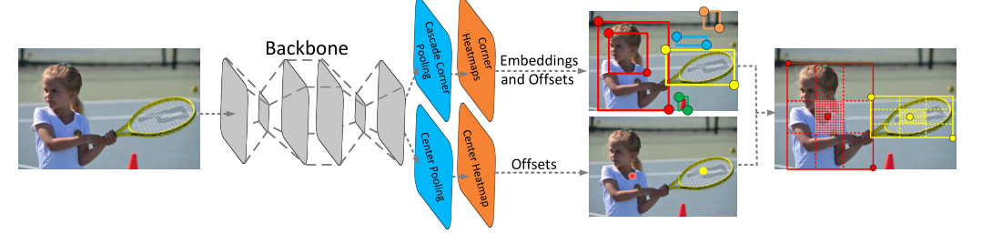
Introduction
Background & Problems
In object detection, the anchor-based method relies on too much manual design, and the training and prediction process is too inefficient. In recent years, one-stage anchor-free methods such as FCOS and CenterNet have made a splash in object detection. They not only have a simple structural design, but also demonstrate competitive performance. However, in industrial applications, the design of its multiple output heads hinders the installation of the model. At the same time, different output heads mean a combination of multiple loss functions. This introduces problems in training. Here, we propose an anchor-free object Detector with Only Heatmaps (DetOH) to solve object detection.

Slide 4
Introduction
Contributions
We proposed an anchor-free object detector with only heatmaps.
We designed the Center Point (CP) loss function to effectively improve the detector performance.
We conducted experiments on the Microsoft COCO dataset and applied the model to embedded devices to demonstrate the effectiveness of our work.

Slide 5
Related Work
Anchor-based Detectors
As shown by Faster R-CNN and RetinaNet, the performance of the detection is sensitive to the size, proportion, and number of anchor boxes.
Detectors difficulty handling object candidates with large shape variations, especially small objects.
They also introduce complex computations into the training process and loss functions, such as calculating IoU.

Slide 6
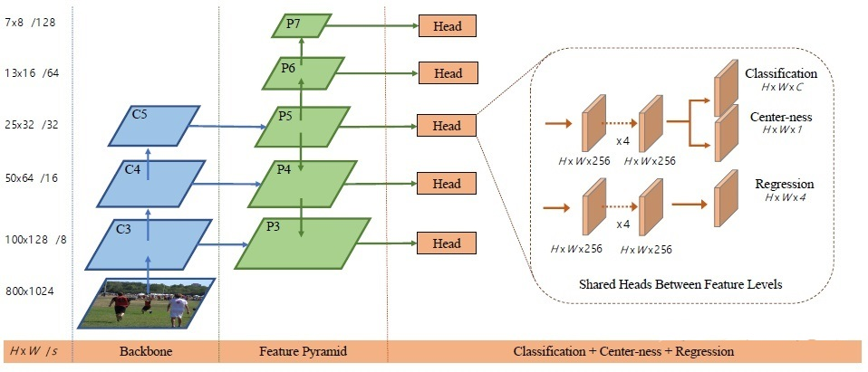
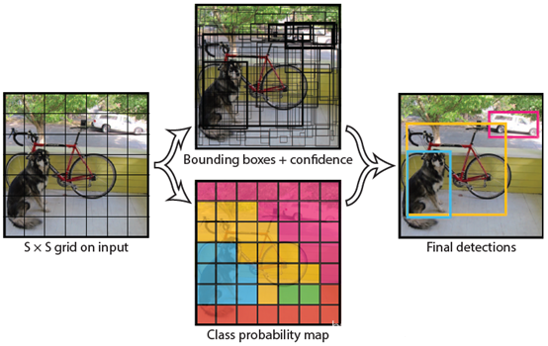
Related Work
YOLO
It predicts points near the center of the object's bounding box because they are believed to be able to produce higher quality detections
FCOS
Anchor-free Detectors
It adds center-ness branching, enabling a better accuracy/speed trade-off.
Anchor-free detectors often have complex output heads. This brings trouble to model training , loss function design and industrial applications.

Slide 7
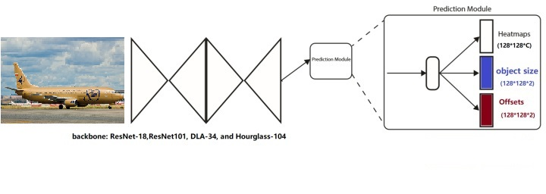
Related Work
CenterNet
As CenterNet first filled the input image into a square and resize it to 512×512. Its output heatmaps was 1/4 the size of the input after downsampling.
The input image passes through the backbone to obtain the feature map, and then enters the prediction module.
CenterNet's output head, the prediction module. It contains Heatmaps, Object size, and Offsets.

Slide 8
Our Approach
output head
(a) shows CenterNet's output head. It contains Heatmaps, Object size, and Offsets.
(b) shows the output head of FCOS. It contains Classification, Center-ness and Regression at different scales.
(c) shows the output head of our method. It only contains Classification Heatmaps. We design the heatmaps to be as large as the input image, so that we can directly get to the object center point without offsets according to the heatmaps.

Slide 9
Our Approach
Heatmaps
CenterNet limited the size of the input image to 512×512 by padding and resizing. The heatmap size was 128×128, and the heat spots of the two objects were circular.
Our method does not need to limit the input image size, and the heat map size is the same size. The heat spot shape of an object is related to its horizontal and vertical size.

Slide 10
Our Approach
Object Size
Center point position. By comparing the maxpooling result with the mean filtering result, the location with the same value is the local maximum point, which is the center of the object.
Size parameters. According to the mapping relationship between the value and the distance from the CP, the corresponding direction size parameter is determined.
Bounding box. In the experiment, we found that fine-tuning the bounding box can alleviate the problem of CP positioning bias.

Slide 11
Our Approach
Loss Function
The loss function adopted is a combination of two loss functions. One is the MSE loss, and the other is the CP Loss designed for the model proposed in this paper.
The mask matrix is defined as the position of the maximum point. In other words, the position of the pooled heatmaps that is equal to the original heatmaps is assigned the value of 1, and the rest is 0.
Multiplying the predicted value and the true value by the mask matrix and dividing the calculation result of the cross-entropy loss function by the modulus of the mask matrix, we can get the CP loss function.

Slide 12
Evaluation
Accuracy
Method | Backbone | AP | AP₅₀ | AP₇₅ | AP_{S} | AP_{M} | AP_{L}
Two-stage methods:
Faster R-CNN by G-RMI | Inception-ResNet-v2 | 34.7 | 55.5 | 36.7 | 13.5 | 38.1 | 52.0
Faster R-CNN+++ | ResNet-101 | 34.9 | 55.7 | 37.4 | 15.6 | 38.7 | 50.9
Faster R-CNN w/ FPN | ResNet-101-FPN | 36.2 | 59.1 | 39.0 | 18.2 | 39.0 | 48.2
Faster R-CNN w/ TDM | Inception-ResNet-v2-TDM | 36.8 | 57.7 | 39.2 | 16.2 | 39.8 | 52.1
One-stage methods:
YOLOv2 | DarkNet-19 | 21.6 | 44.0 | 19.2 | 5.0 | 22.4 | 35.5
SSD | ResNet-101-SSD | 31.2 | 50.4 | 33.3 | 10.2 | 34.5 | 49.8
YOLOv3 | Darknet-53 | 33.0 | 57.9 | 34.4 | 18.3 | 35.4 | 41.9
DSSD | ResNet-101-DSSD | 33.2 | 53.3 | 35.2 | 13.0 | 35.4 | 51.1
RetinaNet | ResNet-101-FPN | 39.1 | 59.1 | 42.3 | 21.8 | 42.7 | 50.2
CornerNet | Hourglass-104 | 40.5 | 56.5 | 43.1 | 19.4 | 42.7 | 53.9
FSAF | ResNeXt-64x4d-101-FPN | 42.9 | 63.8 | 46.3 | 26.6 | 46.2 | 52.7
FCOS | ResNet-101-FPN | 43.2 | 62.4 | 46.8 | 26.1 | 46.2 | 52.8
CenterNet | Hourglass-104 | 44.9 | 62.4 | 48.1 | 25.6 | 47.4 | 57.4
DetOH | Hourglass-104 | 44.7 | 63.1 | 48.1 | 28.3 | 48.4 | 54.7
DetOH | ResNet-101-BiFPN | 46.1 | 65.3 | 49.8 | 29.2 | 49.6 | 56.5

Slide 13
Evaluation
Speed/accuracy trade-off
Speed/accuracy trade-off between DetOH and several recent methods: FCOS, CenterNet, YOLOv3 and RetinaNet. Speed is measured on a NVIDIA 2080Ti GPU. For fair comparison, we only measure the network latency for all detectors. DetOH achieves competitive performance compared with recent methods including anchor-based ones.

Slide 14
Ablation study
Heatmaps
Examples of the heatmap with different r and α. The luminance in the figure reflects the magnitude of the probability heat value. (a) is the image slice of an object box; (b) and (c) are the heatmaps when r is 1, but their α are different with values of 0.5 and 1, respectively; (d) is the heatmap when r is 0.5; (e) and (f) are the heatmaps when r is 2, but their α are different with values of 0.5 and 1, respectively.

Slide 15
Ablation study
Heatmaps
From the probability heat value curves with different hyperparameters, neural networks fit a derivable function more easily. To evaluate the impact of heatmaps generated by different hyperparameter combinations on object detection accuracy, an ablation study was conducted.
 | Degree of polynomial | Attenuation coefficient | AP | AP₅₀ | AP₇₅
(b) | r = 1 | α= 0.5 | 66.6 | 96.0 | 73.9
(c) | r = 1 | α = 1 | 72.5 | 98.3 | 84.3
(d) | r = 0.5 | α= 0.5 | 52.2 | 94.1 | 49.2
(e) | r = 2 | α= 0.5 | 72.3 | 93.7 | 86.8
(f) | r = 2 | α = 1 | 74.4 | 97.5 | 92.7

Slide 16
Ablation study
Loss Function & Boundary Fine-tune
The loss function adopted in this work is a combined loss function, which is replaced by a different loss function to study its effect on the result.
These findings suggest that boundary fine-tuning can play a critical role in improving the accuracy of object detection algorithms.
Loss Function | AP | AP₅₀ | AP₇₅
CE loss | 28.0 | 71.1 | 22.3
Diceloss | 0.483 | 2.45 | 0.121
Focal loss | 23.7 | 61.5 | 24.4
MSEloss | 56.0 | 94.7 | 45.0
Focal loss + CP loss | 44.3 | 82.3 | 39.6
CE loss + CP loss | 55.3 | 91.8 | 58.6
MSE loss + CP loss | 66.6 | 96.0 | 73.9
Boundary Fine-tune | AP | AP₅₀ | AP₇₅
 | 74.4 | 97.5 | 92.7
P | 76.5 | 97.6 | 94.5

Slide 17

Q&A
Thank you for listening

